Slide 1
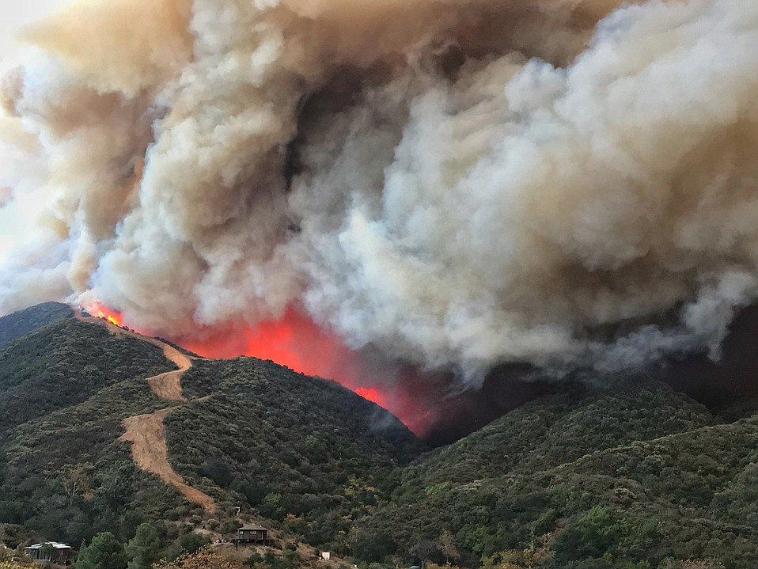



Bottom-up vs Top-down Controls on Wildfires:
Understanding 21st Century California Fires
Jon E. Keeley
U.S. Geological Survey
UCLA
Rancho Santa Ana Botanic Garden
Alexandra D. Syphard
Sage Insurance Holdings, LLC
San Diego State University
Photo: Chris Doolittle
The Santa Barbara Independent
Notes:
Worst Day Yet' on the Thomas Fire as Firefight Continues in MontecitoThe Santa Barbara Independent958 × 719Search by imageSmoke churns off the leading edge of the Thomas Fire as it approaches a fire break

Slide 2
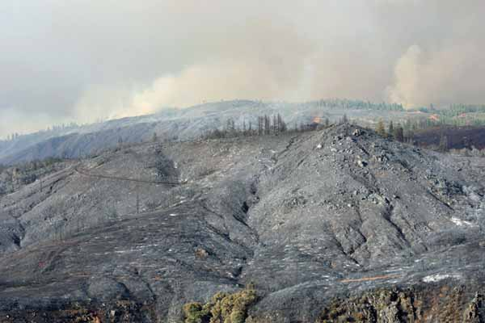

2012 Fire Season:
Rush Fire (Lassen Co) 127,800 ha (315,800 acres)
2013 Fire Season:
Rim Fire (Tuolumne Co) 104,000 ha (257,000 acres)
2015 Fire Season:
Rough Fire (Fresno Co) 61,100 ha (151,600 acres)

Slide 3
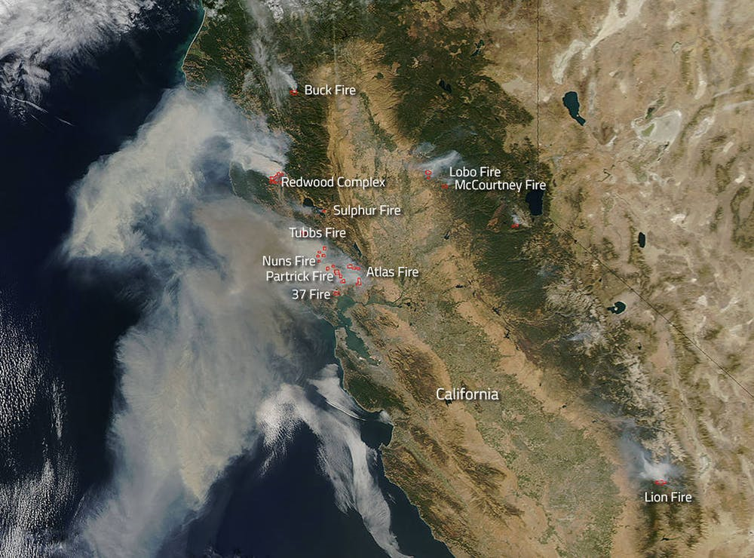
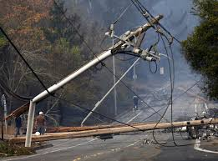
2017 Fire Season
99,000 ha (245,000 acres) 44 fatalities
10,000 structures
Photo: Chris Doolittle

Slide 4
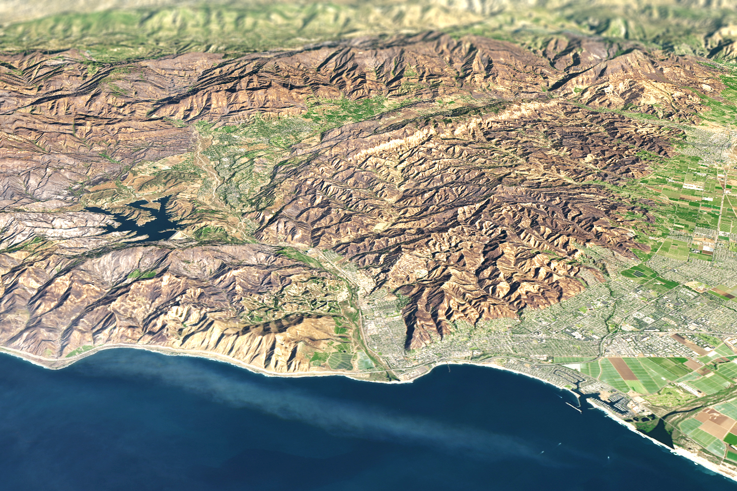
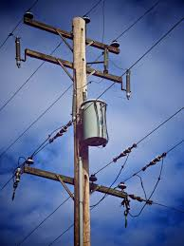
December 2017
Thomas Fire 114,000 ha (280,000 acres)
NASA
NASA Earth Observatory

Slide 5
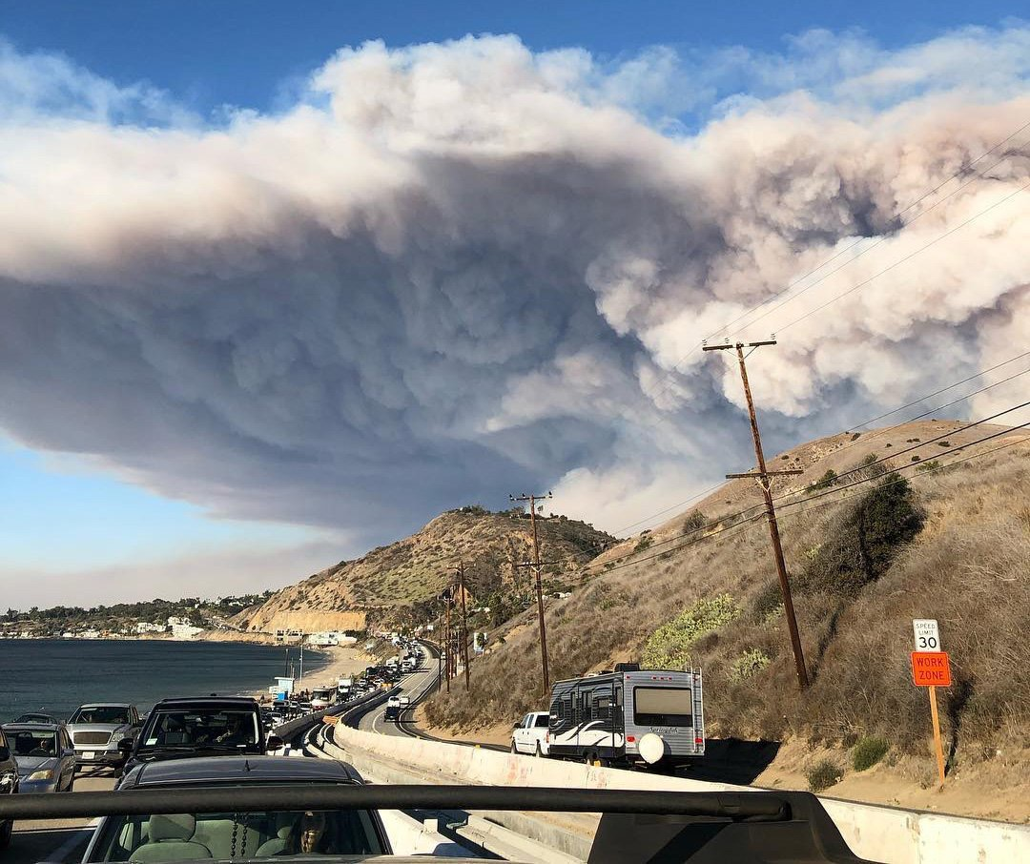
2018 Fire Season
Carr (Shasta, Trinity cos) 92,900 ha (229,600 ac)
Mendocino Complex (River & Ranch fires)
(Colusa, Glenn, Lake, Mendocino) 185,800 ha (459,000 ac)
Camp Fire (Butte) 62,300 ha (154,000 ac) MOST FATALITIES
Woolsey Fire (Ventura Co) 39,200 ha (97,000 ac)

Slide 6
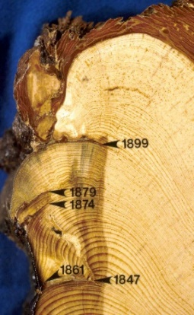
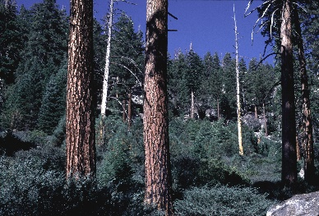
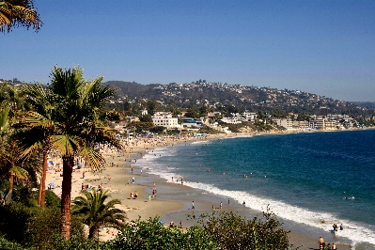
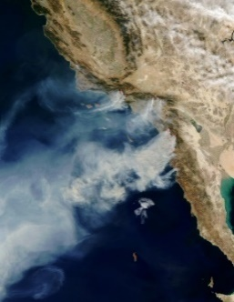
Fire Behavior = f (Fuels, Drought, Wind, Temperature)
The importance of each varies with individual fires,
but two extremes that vary geographically
→ Fuel-dominated fires
Internal controls dominate
Bottom-up
Within our control
→ Wind-dominated fires
External controls dominate
Top-down
Outside our control

Slide 7
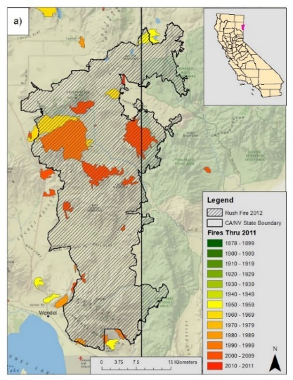
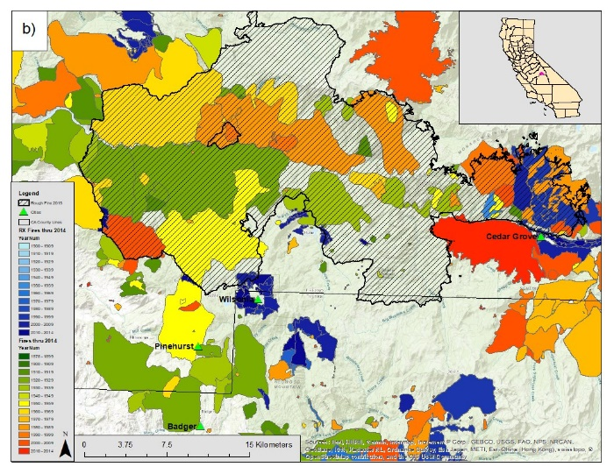
Fuel-dominated fires
Montane forests have historically burned at short intervals, but due to successful fire suppression, have accumulated anomalously high fuel loads
Two California examples show landscapes that had not burned for a century or more at the time of the fire
2012 Rush Fire 2015 Rough Fire

Slide 8
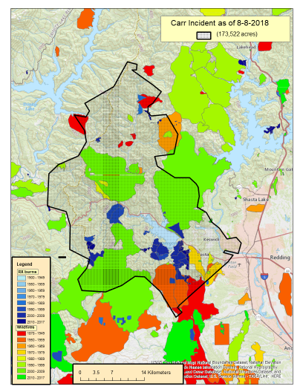
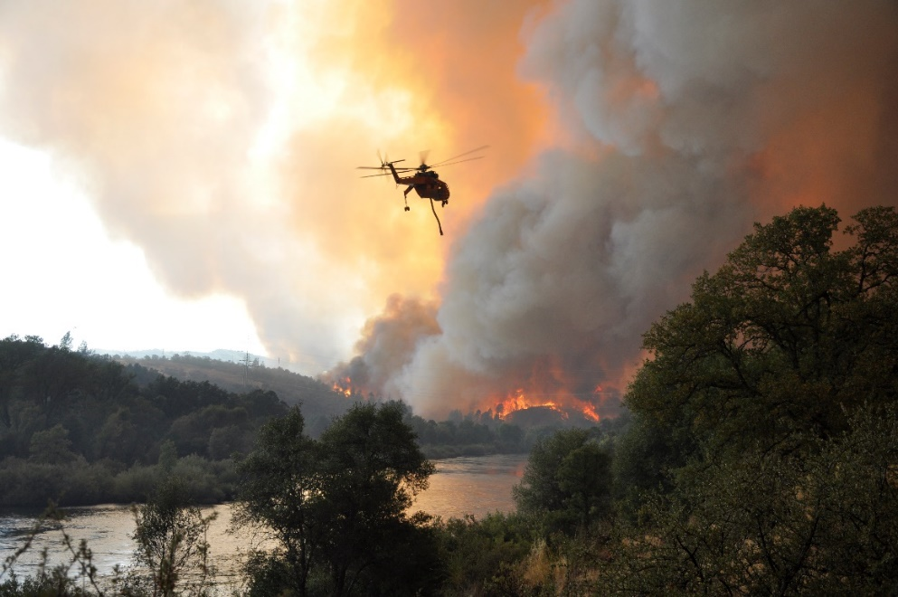
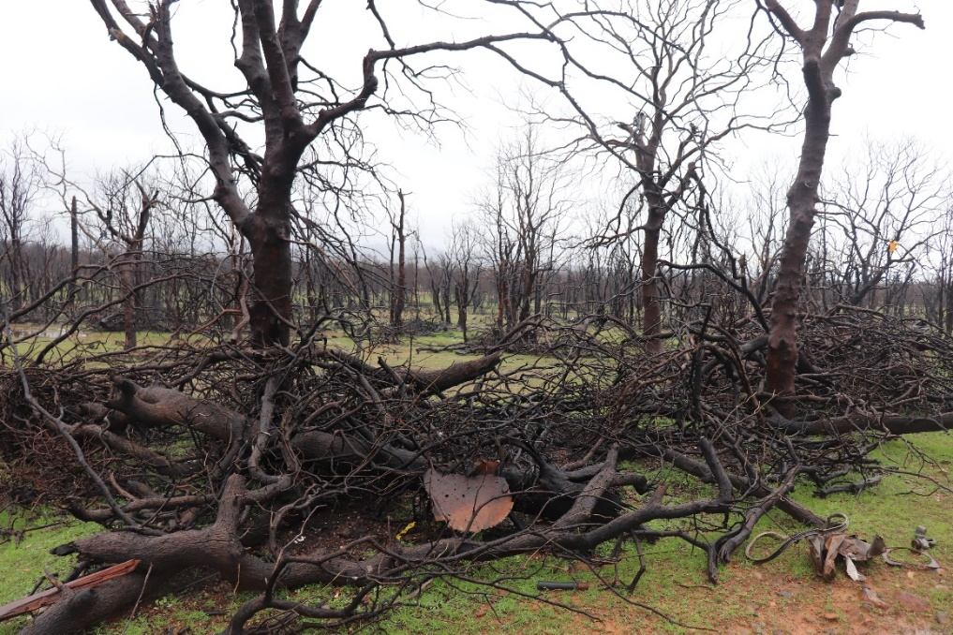

Slide 9
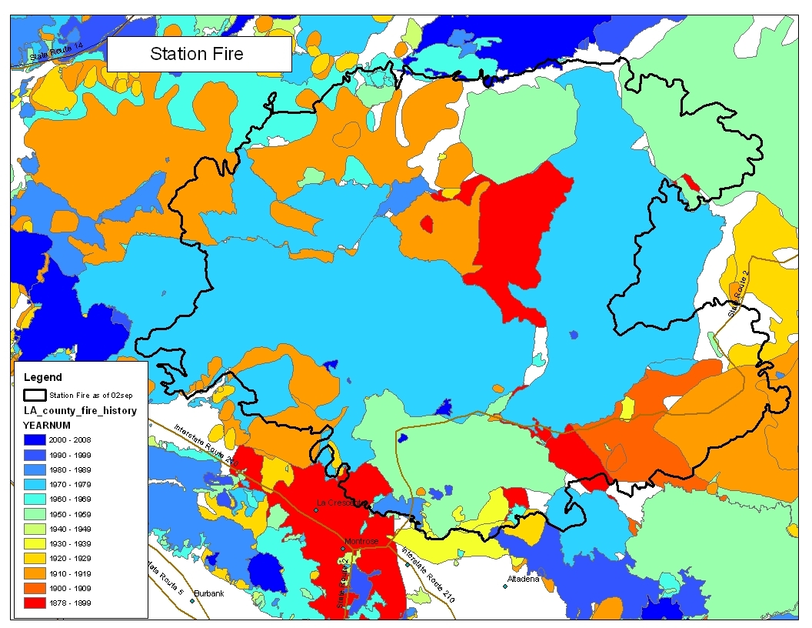
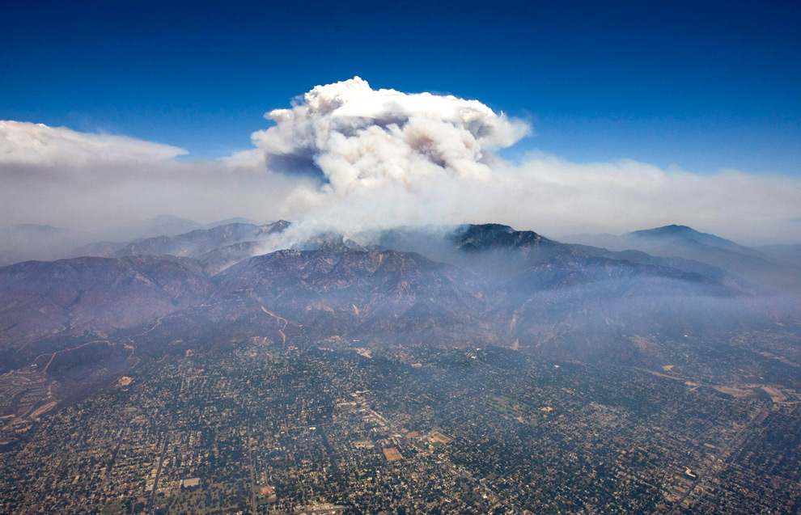

Slide 10
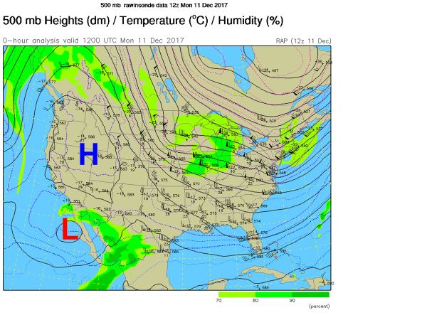
In contrast to bottom-up controls, some of our worst fires are driven by
extreme winds from external factors (foehn winds) = Top-down controls
Photo: Chris Doolittle
Notes:
Southern California's Thomas Fire faces calmer winds, aggressive ...Fox News896 × 504Search by imageSouthern California's Thomas Fire rages on after 2 weeks

Slide 11

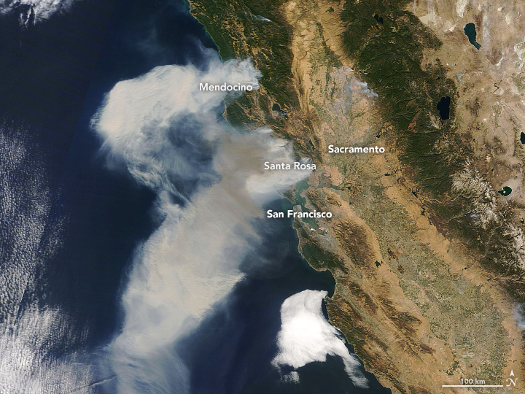
Santa Ana Winds in
southern California
North Winds in northern California
Santa Barbara
Los Angeles
San Diego
These smoke trails show an offshore flow from Autumn foehn winds with
gusts > 70mph & RH < 10%; which in California are annual events.
Other regions, e.g. 2016 Chimney Tops Fire in Gatlinburg, TN (14/1600)
Notes:
that killed 14 persons and destroyed over 1600 structures

Slide 12
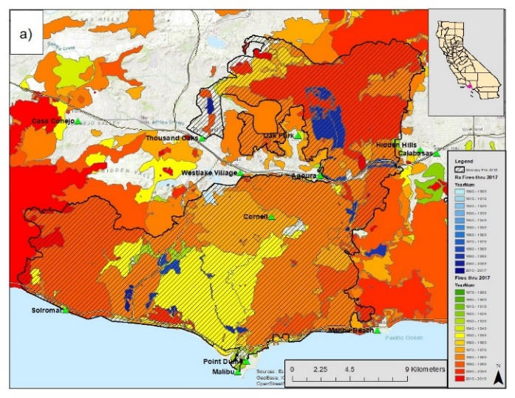
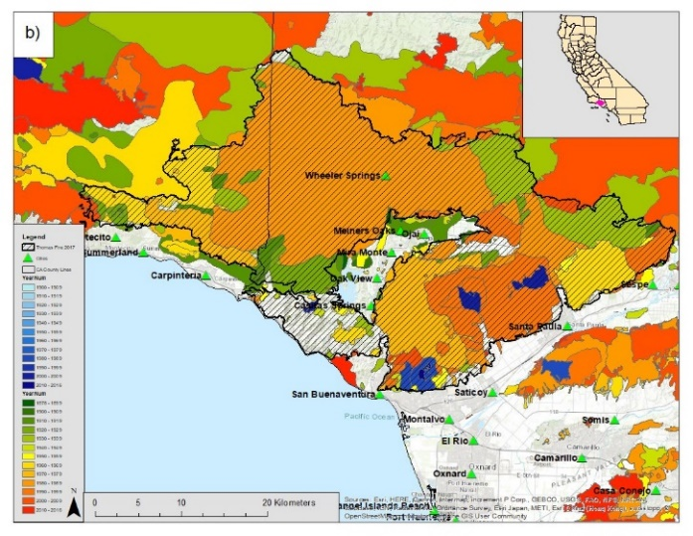
Wind-Dominated Fires
‘All’ are direct/indirect result of human activities and with 40 million people in the state such fires are frequent and thus nearly always burn over landscapes of young fuels.
2018 Woolsey Fire 2017 Thomas Fire
Despite same fire suppression policy, these fires have become more frequent

Slide 13
Fuel vs Wind Fires: Differ in month, cause and destruction
Year Fire County Mon (days) Acres Cause Lives Structures
Fuel-Dominated Fires:
2007 Marble C Monterey July - 177,866 Lightning 0 0
2012 Rush Lassen Aug - 272,000 Lightning 0 1
2013 Rim Stanislaus Aug - 257,513 Campfire 0 112
2015 Rough Fresno July - 151,623 Lightning 0 4
Wind-Dominated Fires:
1889 Santiago Orange Sept (3) 308,900 Campfire 0 0
Laguna San Diego Sept (3) 174,200 Powerline 5 382
2003 Cedar San Diego Oct (3) 270,575 Flares 15 2,820
2007 Witch San Diego Oct (2) 198,175 Powerline 2 1,265
Tubbs Sonoma Oct (2) 36,800 Powerline 22 5,643
2017 Thomas Ventura Dec (10) 281,890 Powerline 2 1,063
2018 Camp Butte Nov (2) 153,336 Powerline 88 18,804

Slide 14
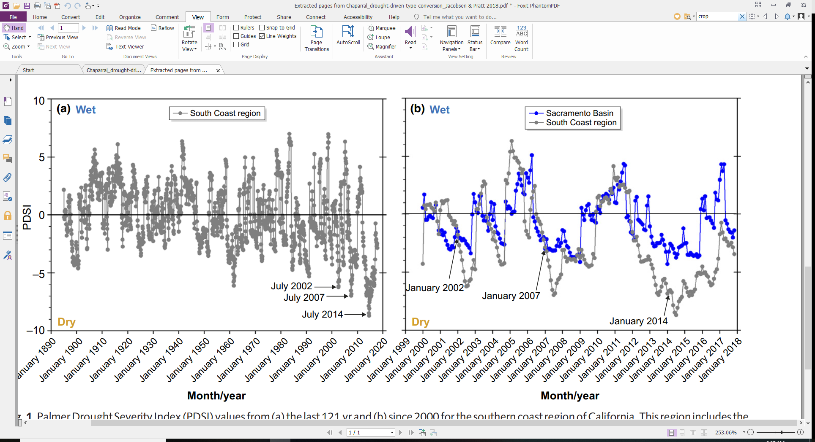
(Jacobson & Pratt 2018)
(Jacco ((( (Jacobsen & Pratt 2018)

Slide 15
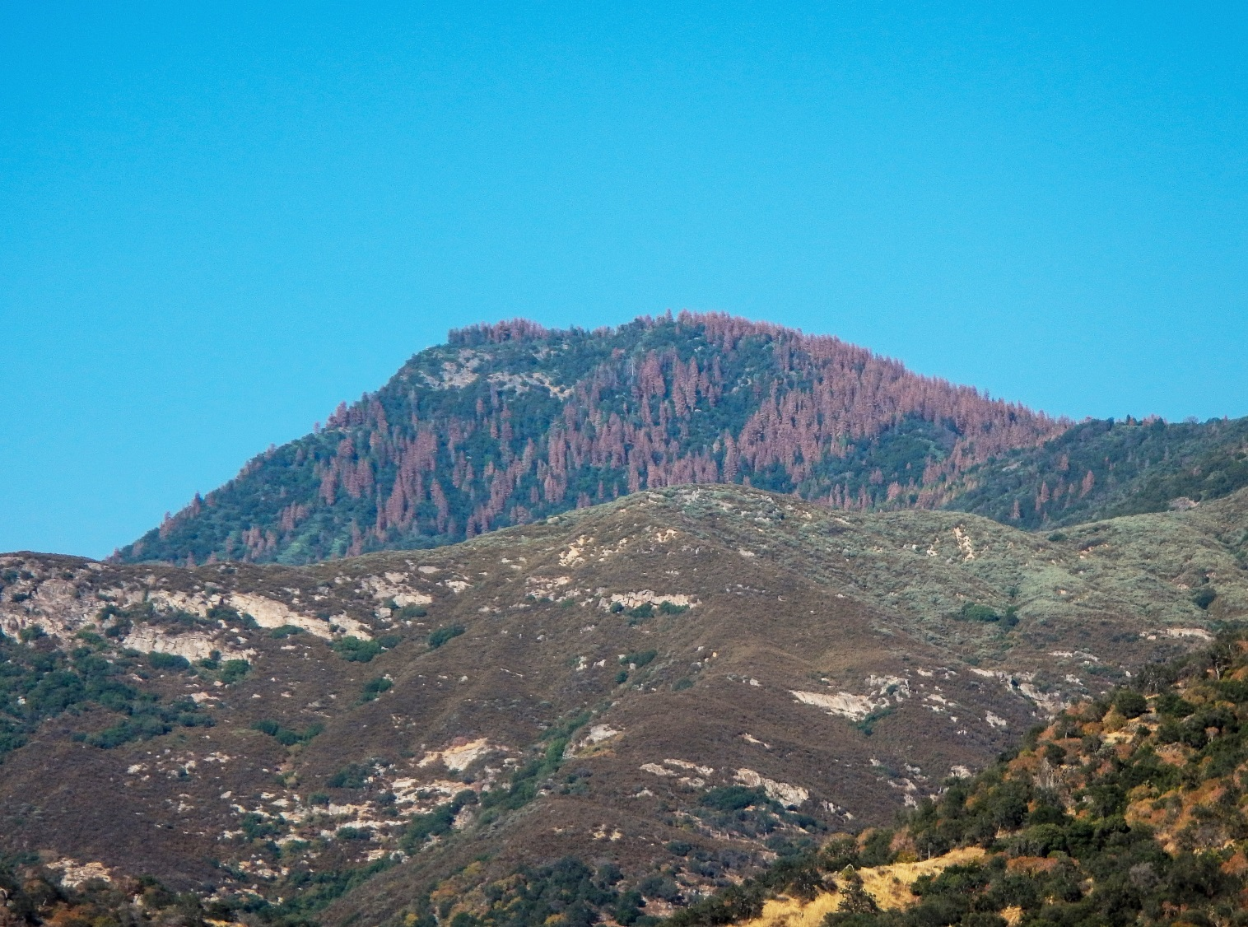

Notes:
In terms of future drought, need to recognize this drought impact may have been exacerbated by past land management
No evidence yet of impact on fires

Slide 16
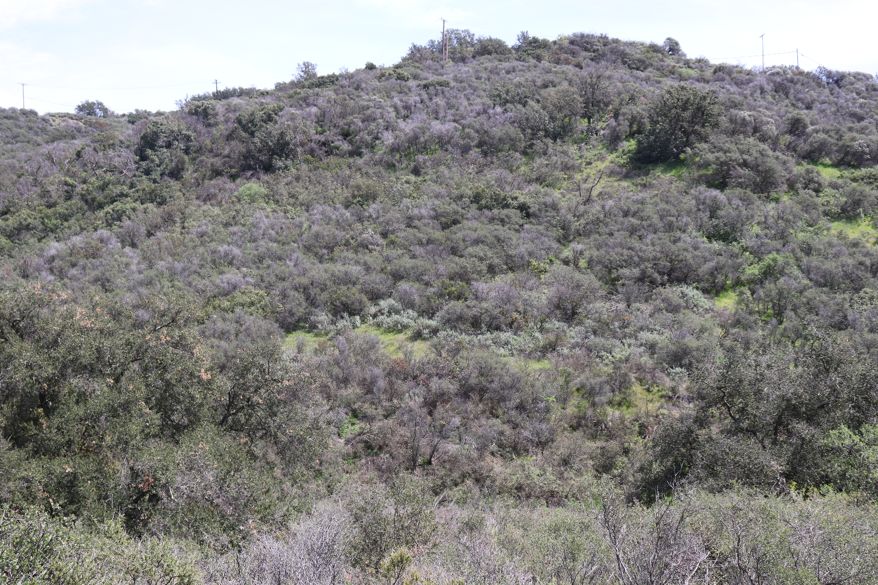
Photo: Chris Doolittle

Slide 17
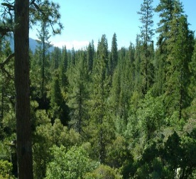
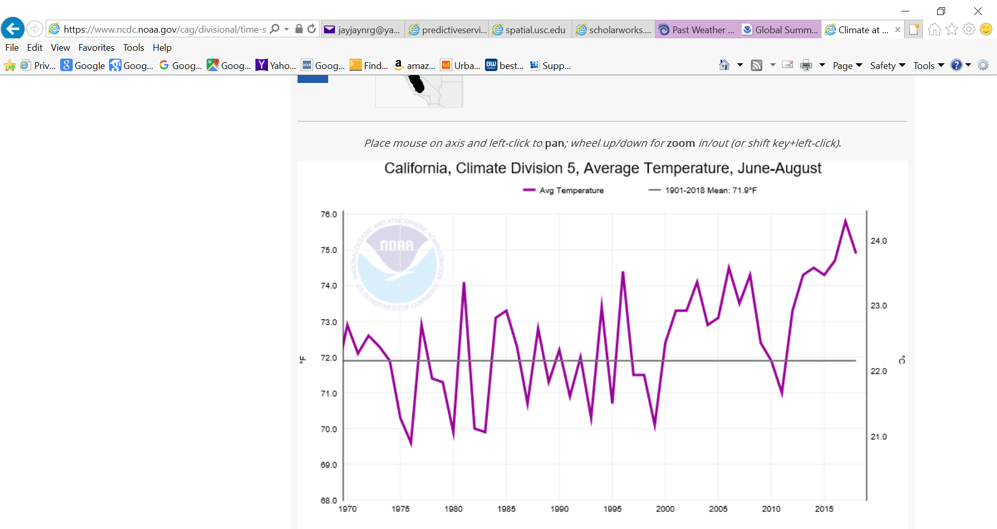
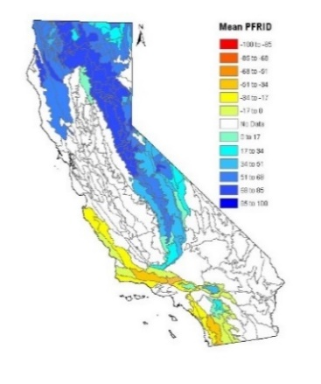
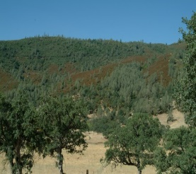
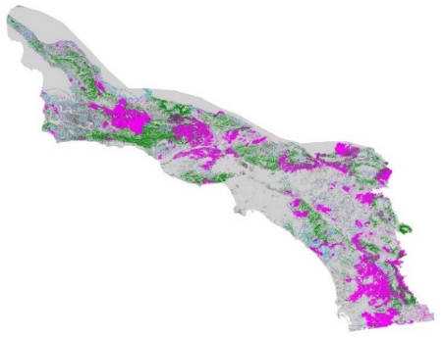

Conclusion: Montane forests most strongly controlled by climate
Consider all seasonal temperatures/ precipitation
Sierra Nevada (USFS) r2
1910 - 2013 0.39 Temp spr+Temp sum-Ppt spr
1910 – 1959 0.42 - Ppt spr - Ppt win
1960 - 2013 0.52 Temp spr + Temp sum
South coast (Cal Fire) r2
1919 - 2013 0.00
1919 - 1959 0.00
1960 - 2013 0.25 Prior ppt-Ppt aut -Ppt sum
Photo: Chris Doolittle
Notes:
Focus on extremes climate limited and non-climate limited
19.5
Obvioulsy more than a single parameter up to 52%
Climate model changes ppt for temp

Slide 18
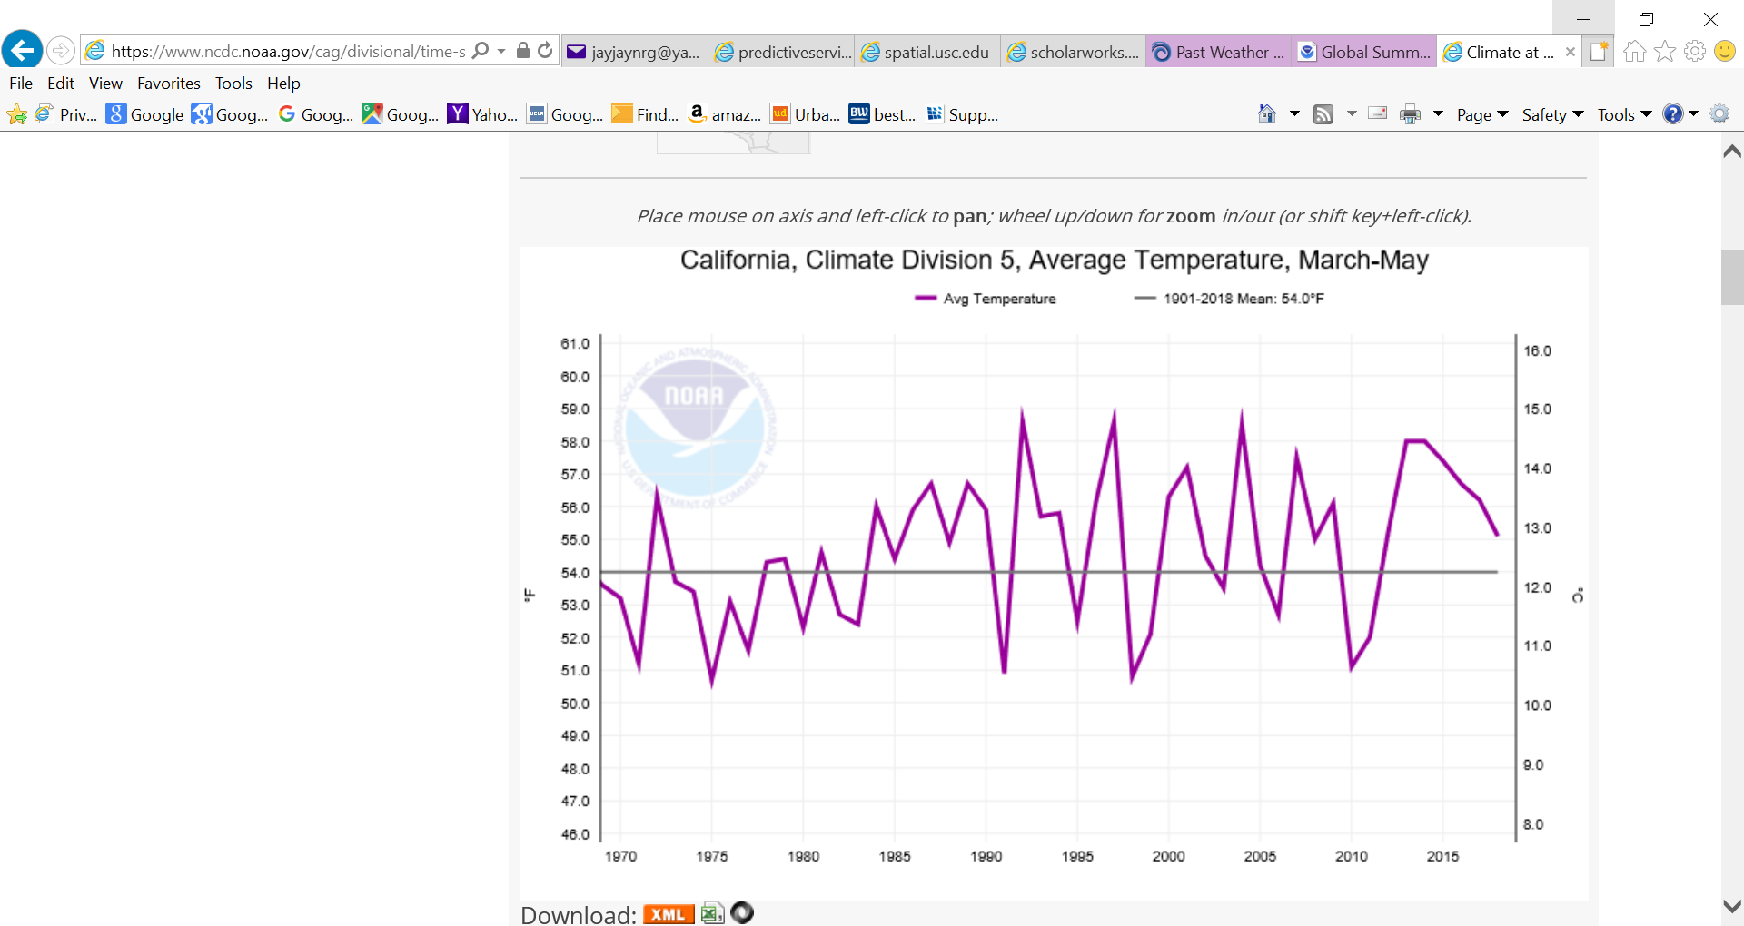

Slide 20
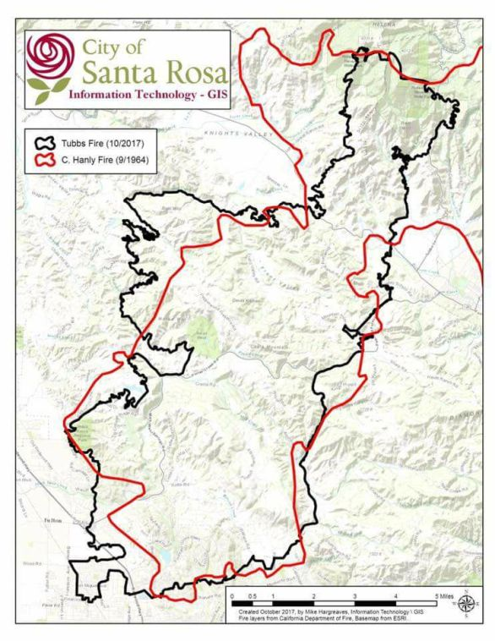
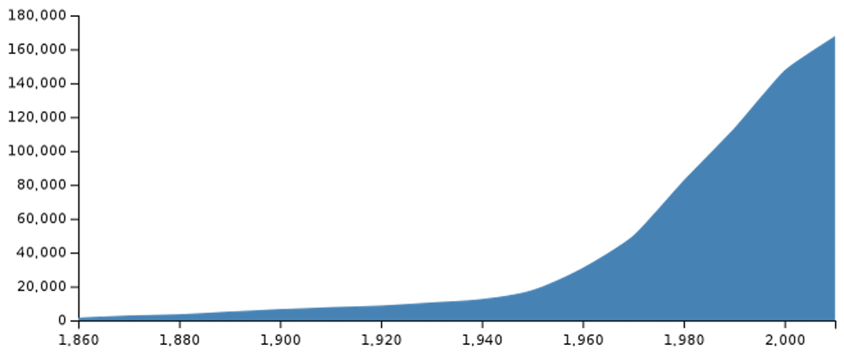
1964 Hanly Fire 83,000 acres
(no fatalities/~100 structures lost)
2017 Tubbs Fire 36,800 acres
(22 fatalities / 5,643 structures lost)
Hanly Tubbs
Notes:
unusually strong, sharp high pressure / deep trof couplet that created the high wind, low humidity in Santa Rosa region
700 mb height anomaly Oct 8-9 2017

Slide 21
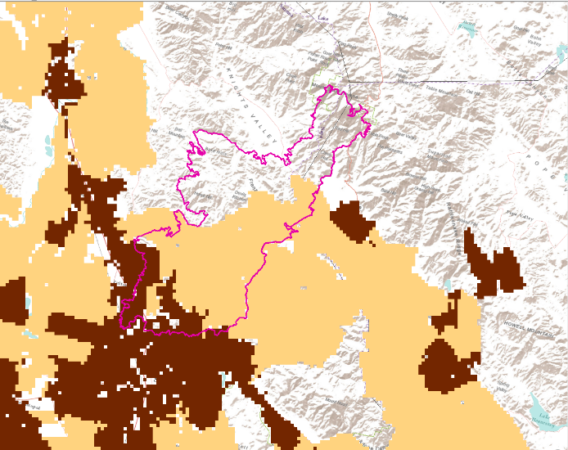
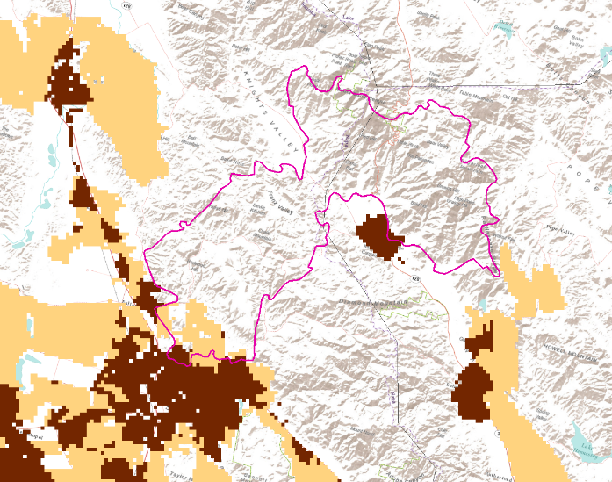
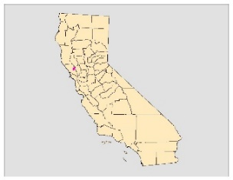

a) 1964 Hanly Fire
b) 2017 Tubbs Fire
Low-density housing development
High-density housing development

Slide 22
Management Solutions
Differ markedly between:
→ Fuel-dominated fires
Bottom-up factors are
within our control
→ Wind-dominated fires
Top-down factors are
outside our control

Slide 23
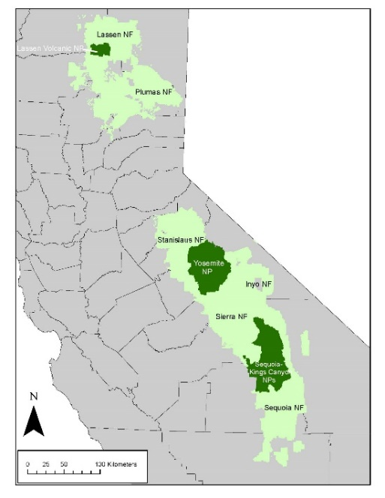
Fuel-dominated fires:
Total Rx Burning Since 1960
Rx Burning in Last 10 Years
SEKI Seq Sie YOSE Inyo Sta LAVO Plu Las
(Keeley, Pfaff & Caprio in prep)

Slide 24
The 5 Ps of Wind-Dominated Fires:
These are more a People problem than a fuel problem, requiring
greater focus on Prevention, Planning, Protection & Prediction
Prevention: Number of fires across California have declined steadily since 1985, but area burned has increased. In the last decade the majority of large fires have been ignited by powerline failures, an area of on-going USGS research.
Plannning: Community planning needs to give fire similar recognition as given to other hazards. We have limited ability to control earthquakes and floods, so we have zoning restrictions. Fires have been perceived as controllable, but history reveals we are vulnerable. There is a need for greater focus on fire-zoning and consideration of replacing community planning with regional planning.
Protection: Focus needs to be on the ‘house out’, i.e., greatest effort near homes and less as one moves further into the wildlands. Reducing fuels within 100’ is critical for defensible space, however, most homes burn from embers and thus reducing litter on roofs and adequate attic vents are important. Less flammable materials, double-pane windows and roof sprinklers may make a difference.
Prediction: Real time prediction of wind patterns and communicating that information to fire-fighting agencies and homeowners could save lives.
Notes:
Much has been written on management needs to prevent fuel-dominated fires
Far less has been said on the appropriate responses for wind-dominated fires

Slide 25
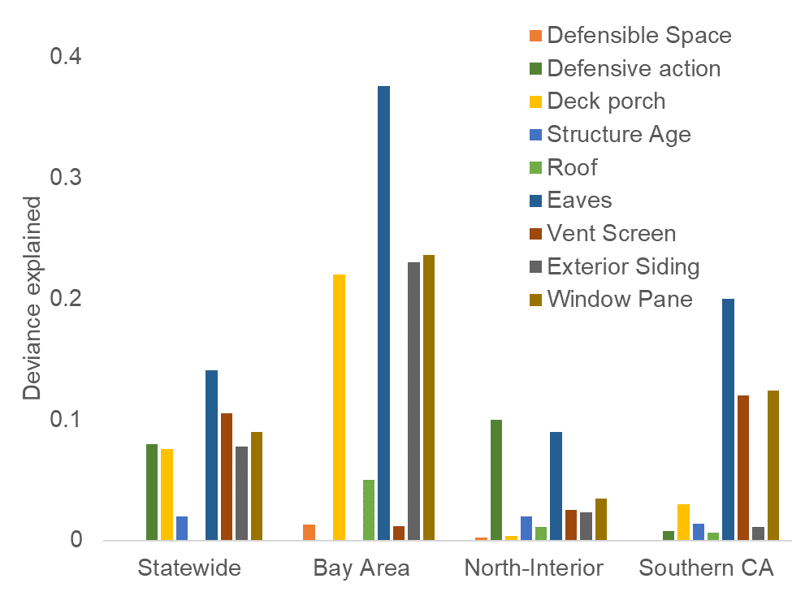

Slide 26
Deck, Porch material
Composite vs others | 0.85 | 0.0001 | 0.93 | 0.007 | 0.92 | 0.03 | 0.78 | 0.04
Masonry vs others | 1.002 | 0.48 | 1.17 | 0.0001 | 0.99 | 0.03 | 1 | 0.78
Wood vs others | 0.98 | 0.01 | 1 | 0.6 | 1.01 | 0.002 | 0.97 | 0.27
None | 1.01 | 0.10 | 0.35 | 0.0001 | 1 | 0.24 | 1.02 | 0.25
Roof type
Asphalt vs others | 1.05 | 0.0001 | -- | -- | 1.03 | 0.0001 | 1.02 | 0.4
Concrete vs others | 0.89 | 0.0007 | -- | -- | 0.94 | 0.05 | 0.82 | 0.04
Metal vs others | 0.97 | 0.0001 | -- | -- | 0.98 | 0.001 | 1.04 | 0.14
Tile vs others | 0.88 | 0.0001 | -- | -- | 0.89 | 0.0001 | 0.97 | 0.25
Wood vs others | 1 | 0.84 |  |  | 0.99 | 0.96 | 1.06 | 0.38
Combustible vs resistant | -- | -- | 1 | 0.75 | -- | -- | -- | --
Eaves
Enclosed vs others | 0.79 | 0.0001 | 0.88 | 0.0001 | 0.95 | 0.0001 | 0.83 | 0.0001
None vs others | 1.06 | 0.0001 | 0.49 | 0.0001 | 1.02 | 0.004 | 1.35 | 0.0001
Unenclosed vs others | 1.04 | 0.0001 | 1.15 | 0.0001 | 1.5 | 0.0001 | 0.99 | 0.86
Vent screen
Screened vs unscreened | 0.94 | 0.0001 | 0.76 | 0.0001 | 0.97 | 0.0001 | 0.95 | 0.23
Exterior siding
Combustible vs resistant | 1.05 | 0.0001 | 1.03 | 0.0002 | 1.04 | 0.0001 | 1.07 | 0.0001
Window panes
Multi vs others | 0.94 | 0.0001 | 0.94 | 0.0001 | 0.97 | 0.0001 | 0.74 | 0.0001
None vs others | 1.01 | 0.12 | 0.25 | 0.0001 | 0.98 | 0.04 | 1.14 | 0.01
Unenclosed vs others | 1.06 | 0.0001 | 1.05 | 0.0001 | 1.02 | 0.0001 | 1.12 | 0.0001
(Syphard & Keeley in review)

Slide 27
Deck, Porch material
Composite vs others | 0.85 | 0.0001 | 0.93 | 0.007 | 0.92 | 0.03 | 0.78 | 0.04
Masonry vs others | 1.002 | 0.48 | 1.17 | 0.0001 | 0.99 | 0.03 | 1 | 0.78
Wood vs others | 0.98 | 0.01 | 1 | 0.6 | 1.01 | 0.002 | 0.97 | 0.27
None | 1.01 | 0.10 | 0.35 | 0.0001 | 1 | 0.24 | 1.02 | 0.25
Roof type
Asphalt vs others | 1.05 | 0.0001 | -- | -- | 1.03 | 0.0001 | 1.02 | 0.4
Concrete vs others | 0.89 | 0.0007 | -- | -- | 0.94 | 0.05 | 0.82 | 0.04
Metal vs others | 0.97 | 0.0001 | -- | -- | 0.98 | 0.001 | 1.04 | 0.14
Tile vs others | 0.88 | 0.0001 | -- | -- | 0.89 | 0.0001 | 0.97 | 0.25
Wood vs others | 1 | 0.84 |  |  | 0.99 | 0.96 | 1.06 | 0.38
Combustible vs resistant | -- | -- | 1 | 0.75 | -- | -- | -- | --
Eaves
Enclosed vs others | 0.79 | 0.0001 | 0.88 | 0.0001 | 0.95 | 0.0001 | 0.83 | 0.0001
None vs others | 1.06 | 0.0001 | 0.49 | 0.0001 | 1.02 | 0.004 | 1.35 | 0.0001
Unenclosed vs others | 1.04 | 0.0001 | 1.15 | 0.0001 | 1.5 | 0.0001 | 0.99 | 0.86
Vent screen
Screened vs unscreened | 0.94 | 0.0001 | 0.76 | 0.0001 | 0.97 | 0.0001 | 0.95 | 0.23
Exterior siding
Combustible vs resistant | 1.05 | 0.0001 | 1.03 | 0.0002 | 1.04 | 0.0001 | 1.07 | 0.0001
Window panes
Multi vs others | 0.94 | 0.0001 | 0.94 | 0.0001 | 0.97 | 0.0001 | 0.74 | 0.0001
None vs others | 1.01 | 0.12 | 0.25 | 0.0001 | 0.98 | 0.04 | 1.14 | 0.01
Unenclosed vs others | 1.06 | 0.0001 | 1.05 | 0.0001 | 1.02 | 0.0001 | 1.12 | 0.0001

Slide 28
The 5 Ps of Wind-Dominated Fires:
These are more a People problem than a fuel problem, requiring
greater focus on Prevention, Planning, Protection & Prediction
Prevention: Number of fires across California have declined steadily since 1985, but area burned has increased. In the last decade the majority of large fires have been ignited by powerline failures, an area of on-going USGS research.
Plannning: Community planning needs to give fire similar recognition as given to other hazards. We have limited ability to control earthquakes and floods, so we have zoning restrictions. Fires have been perceived as controllable, but history reveals we are vulnerable. There is a need for greater focus on fire-zoning and consideration of replacing community planning with regional planning.
Protection: Focus needs to be on the ‘house out’, i.e., greatest effort near homes and less as one moves further into the wildlands. Reducing fuels within 100’ is critical for defensible space, however, most homes burn from embers and thus reducing litter on roofs and adequate attic vents are important. Less flammable materials, double-pane windows and roof sprinklers may make a difference.
Prediction: Real time prediction of wind patterns and communicating that information to fire-fighting agencies and homeowners could save lives.
Notes:
Much has been written on management needs to prevent fuel-dominated fires
Far less has been said on the appropriate responses for wind-dominated fires

